Slide 1
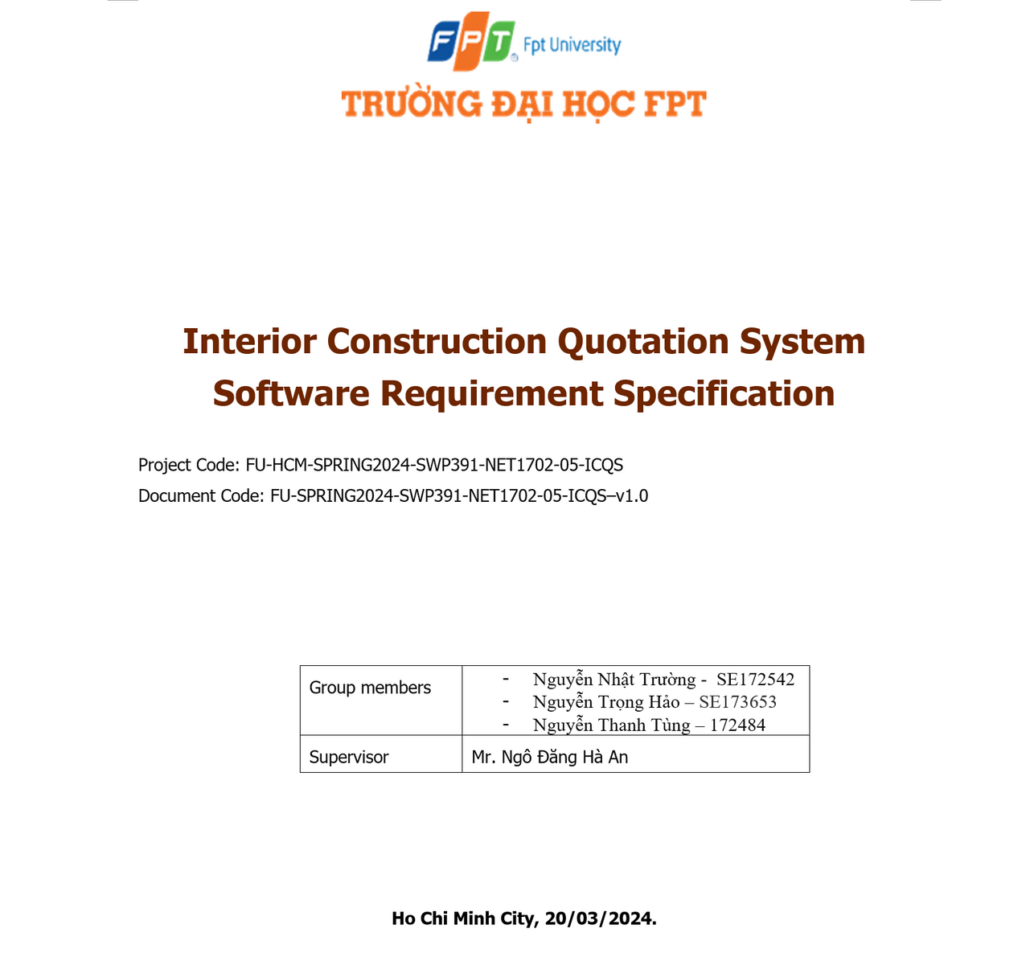
Supervisor: Ngô Đăng Hà An
Team members:
Nguyễn Trọng Hảo - SE173653 - Leader
Nguyễn Thanh Tùng - SE172484
Nguyễn Nhật Trường - SE172542
Ho Chi Minh, April 5,2024

Slide 2
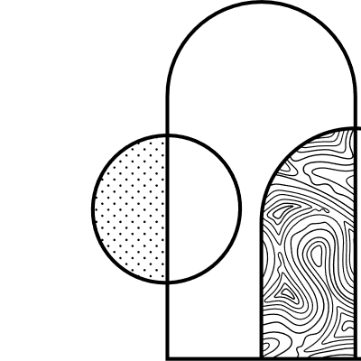

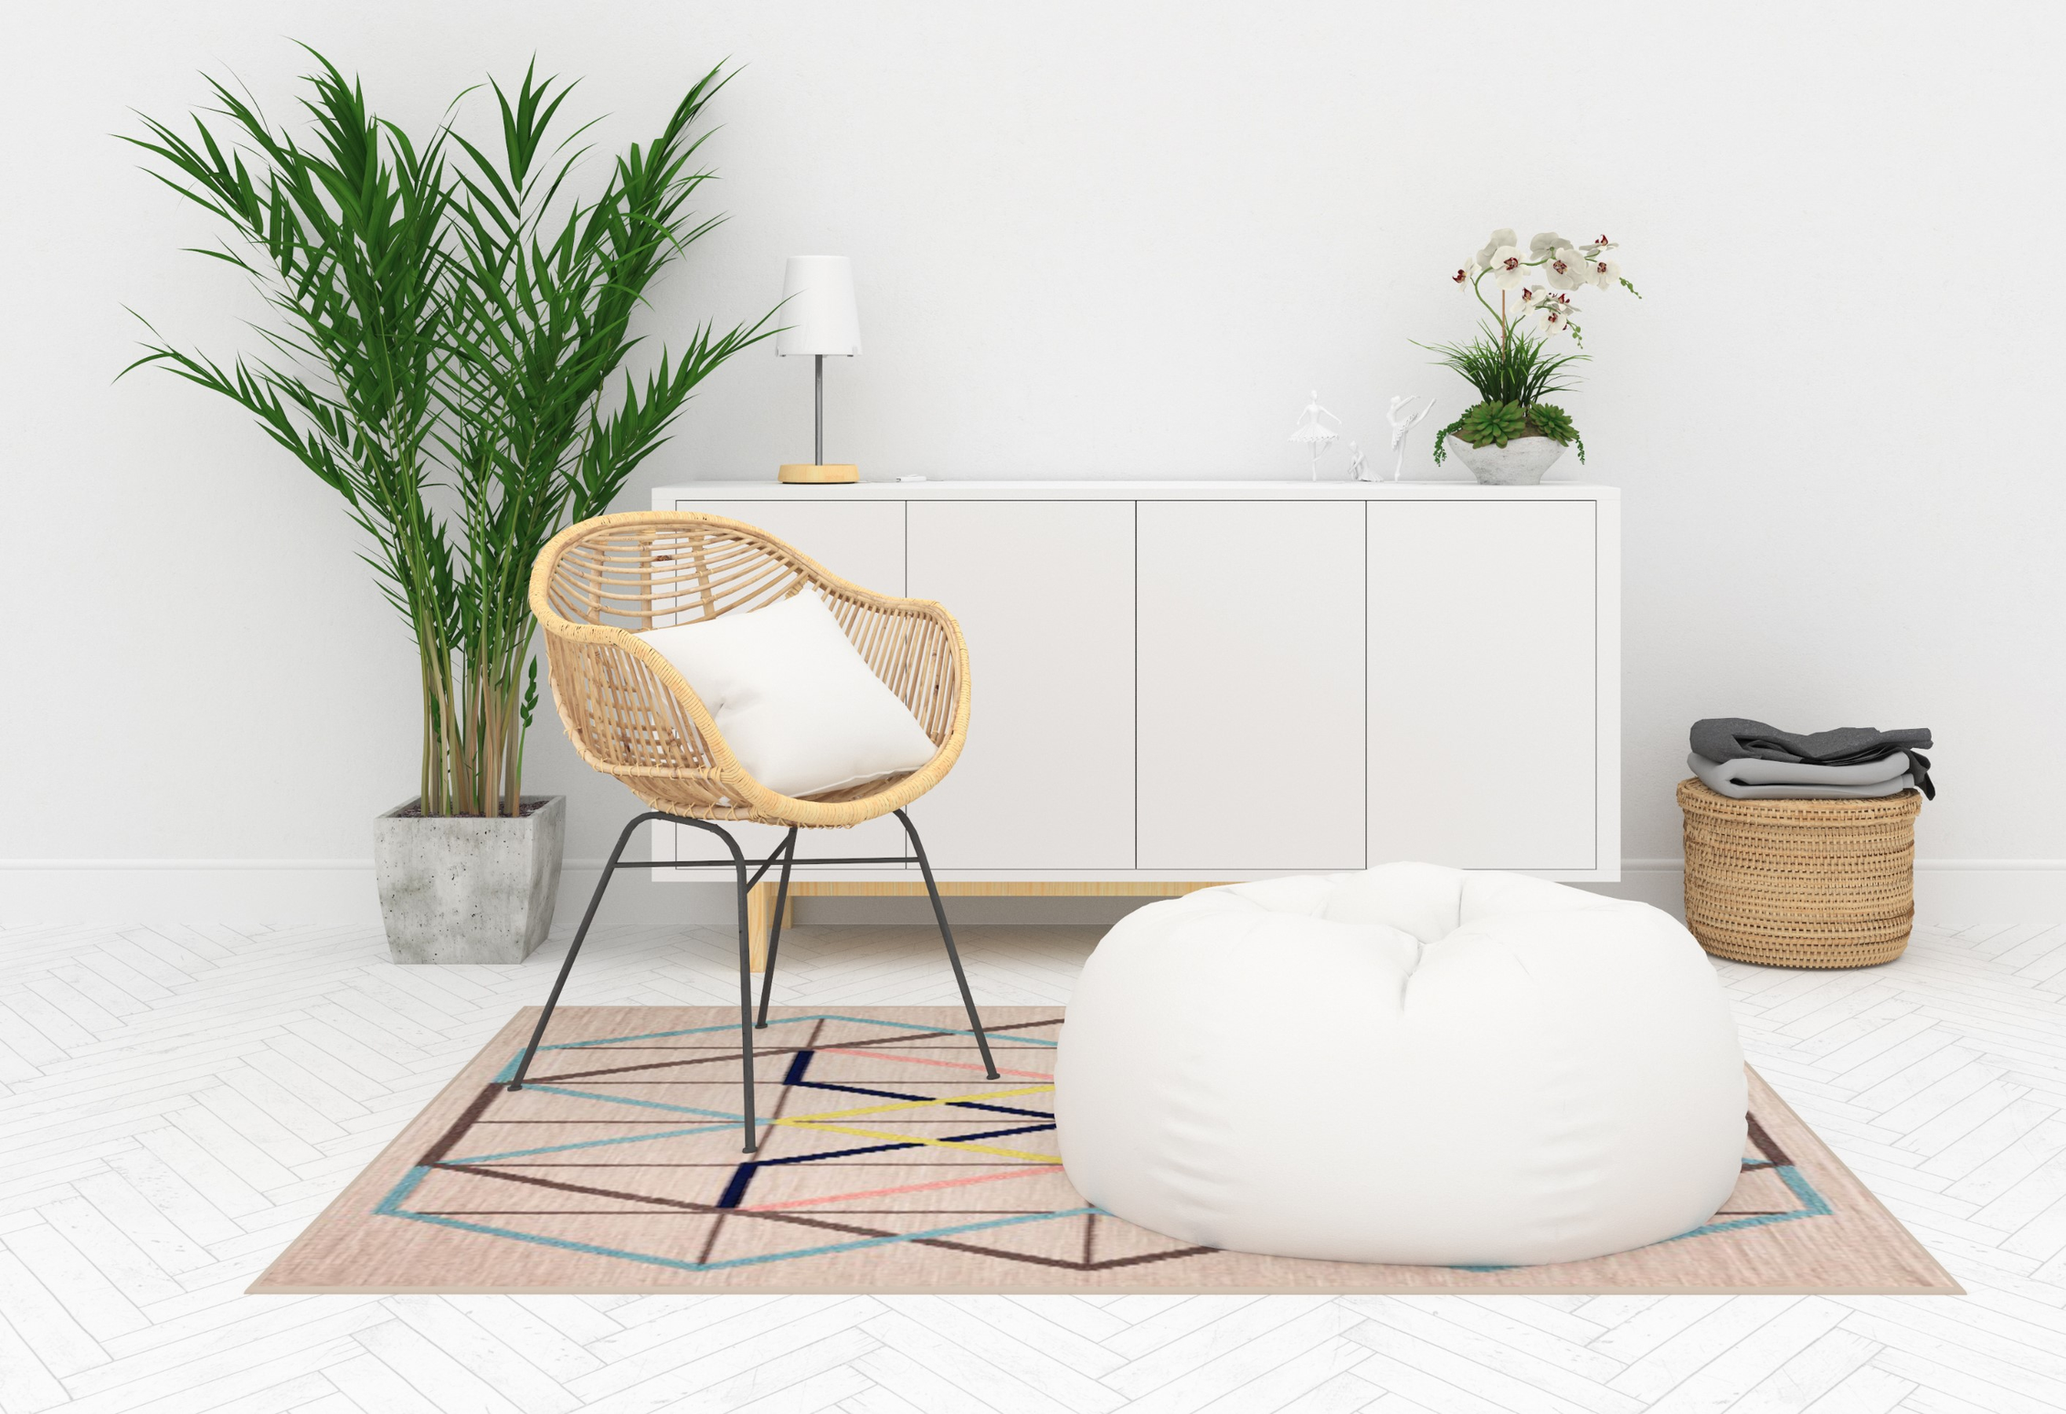
Interior Construction Quotation System
Furniture web is a system for managing the interior construction quotation process
Furniture Website
About Us
Service
Our Projects
March 28, 2024

Slide 3
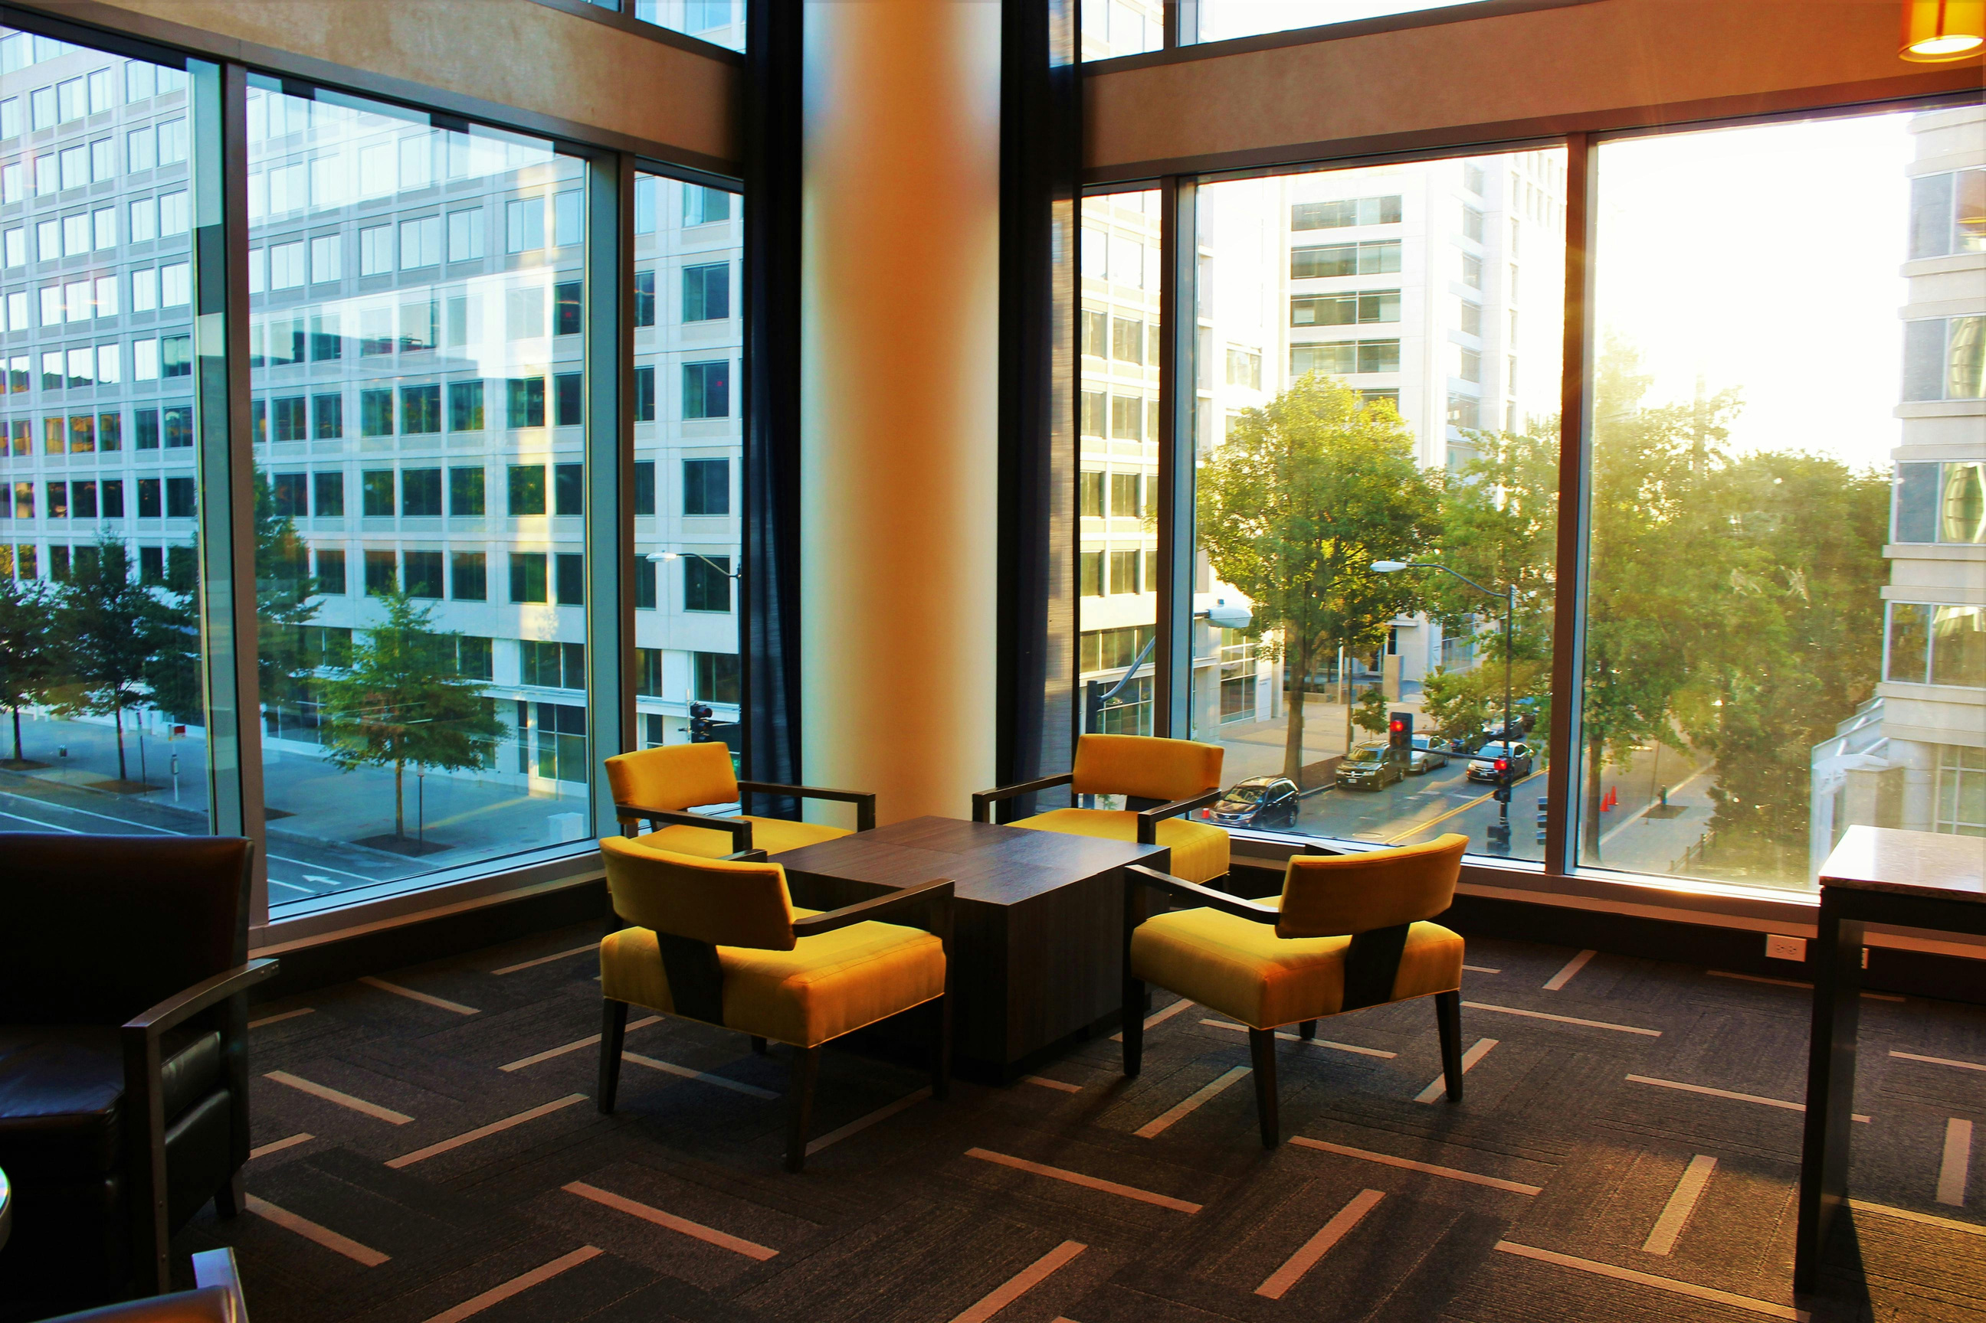
Furniture Website
March 15, 2024
Contens
Introduction
Our Projects
About Website

Slide 4
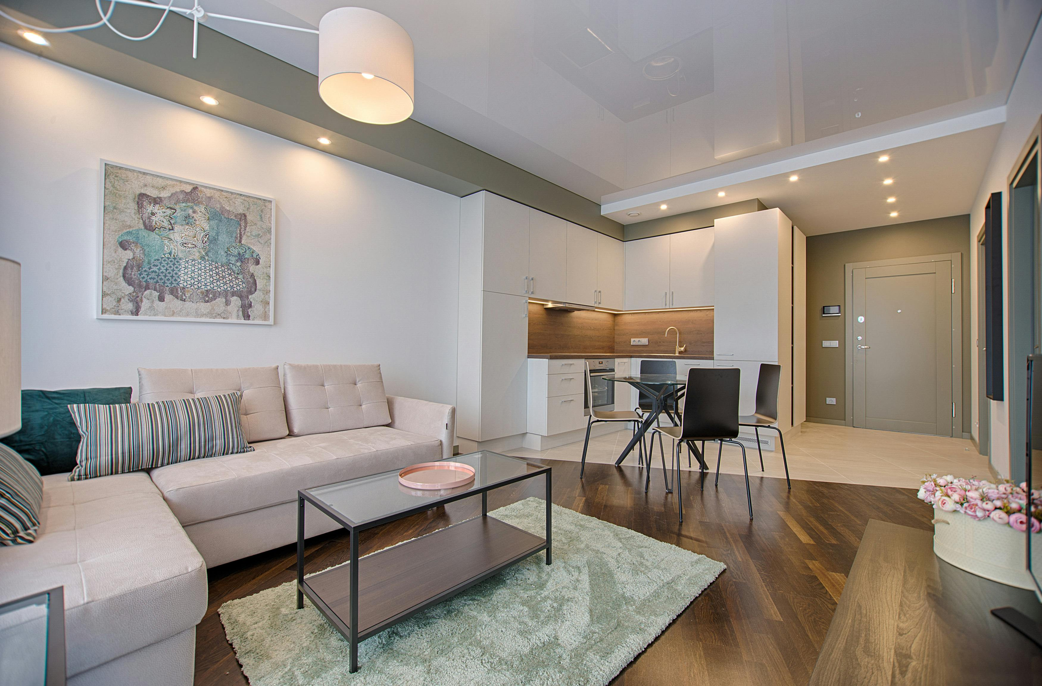
Furrniture Website
March 15, 2024
Introduction

Slide 5
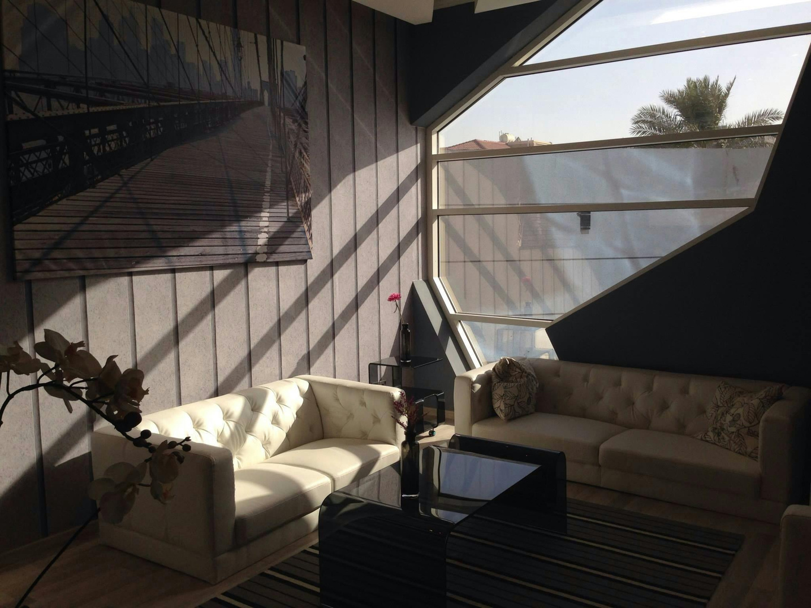
FPT University
Furniture Website
How about project?
This is an interior construction website, and manages the interior construction quote process
What we do?
Based on the quote management cycle, build a closed, complete process from temporary quotes to preliminary detailed quotes.
Scope: Quote for interior construction of townhouses and apartments according to construction space
Mission
Ensuring customers have a complete website in terms of appearance and use, where they can refer to styles, interior architecture, and operating procedures for a quote cycle.
Vision
The first version provides an overview of the website and the main process in quote management

Slide 6
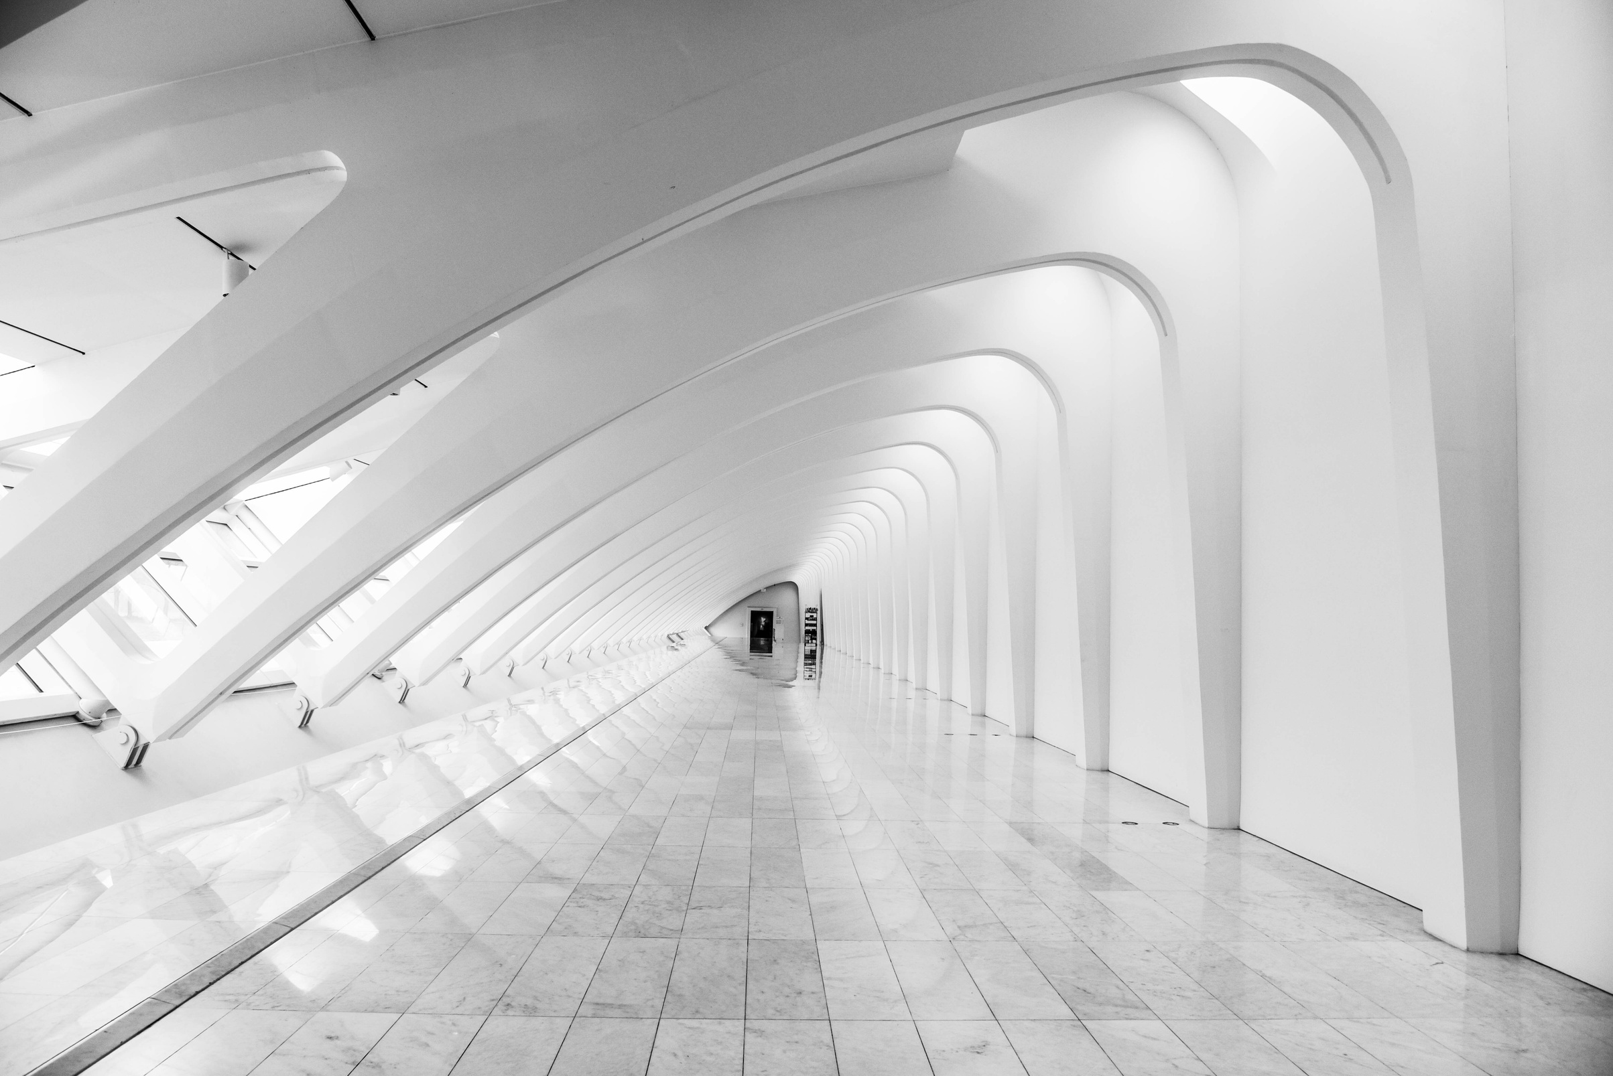
Our Projects

Slide 7
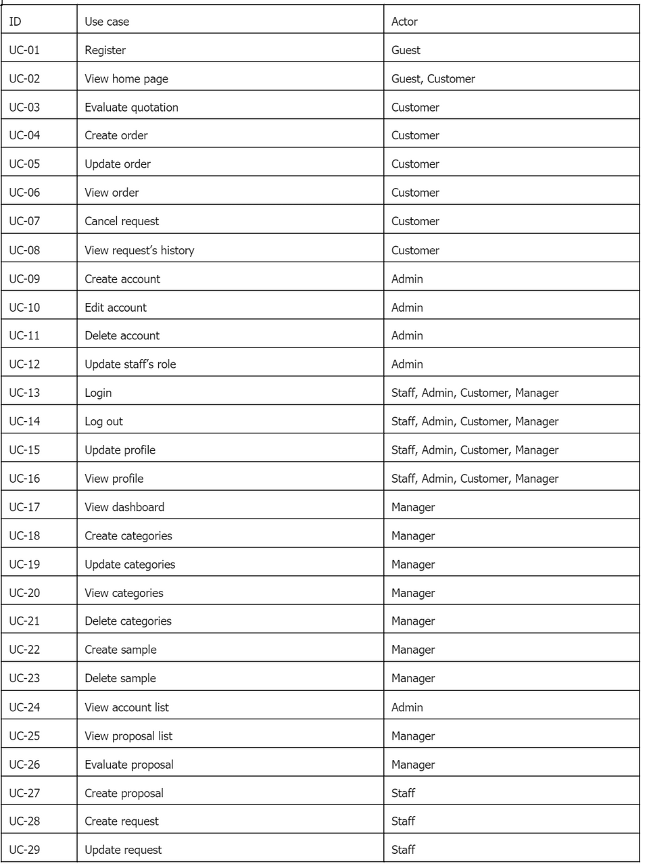
Interior Construction
Quotation System
Main actors:
Guest
Customer
Staff
Manager
Admin
Features:

Slide 8
Guest

Slide 9
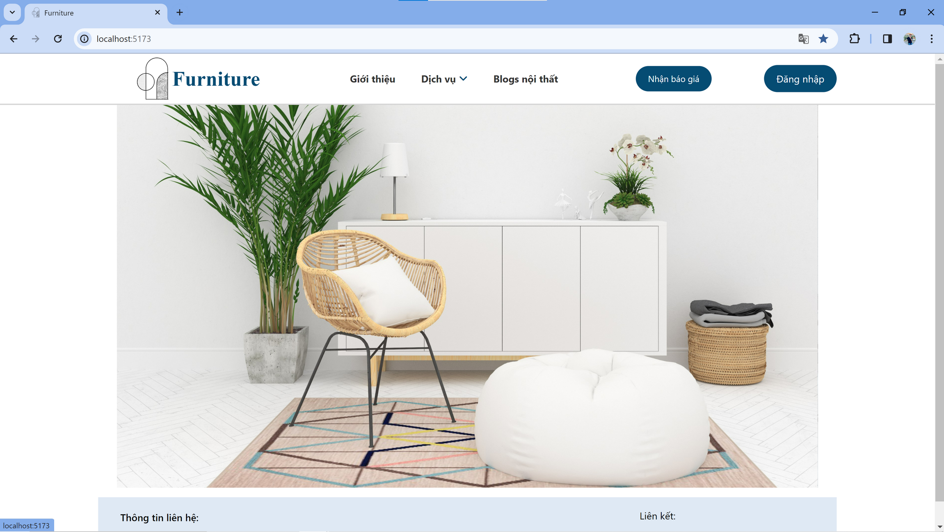

Slide 10
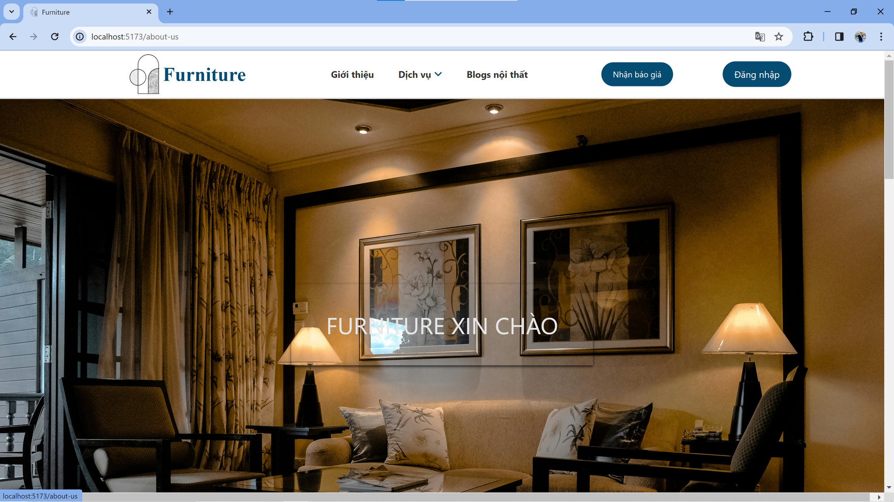

Slide 11
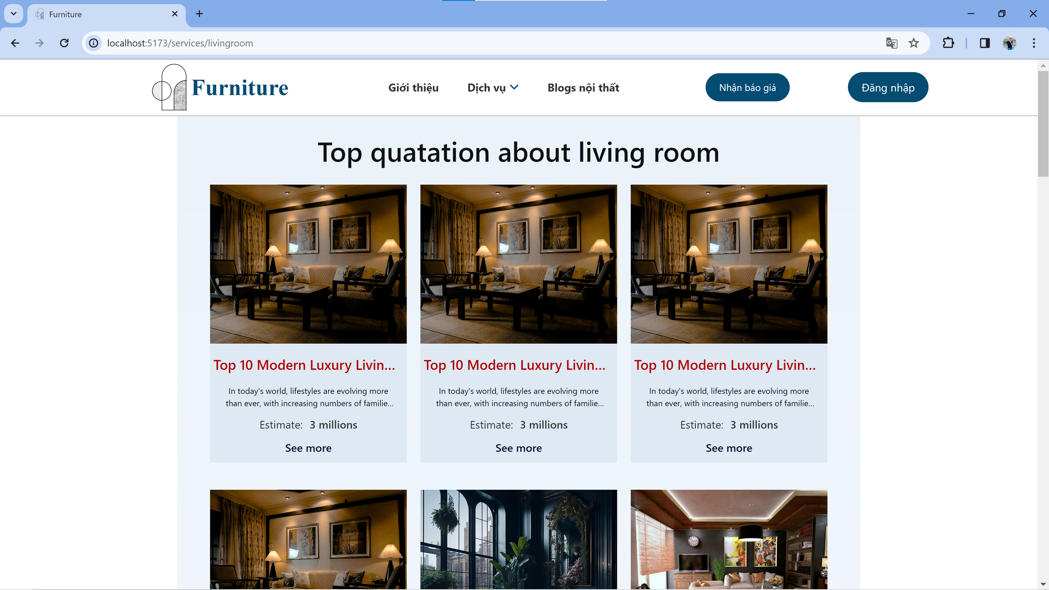

Slide 12
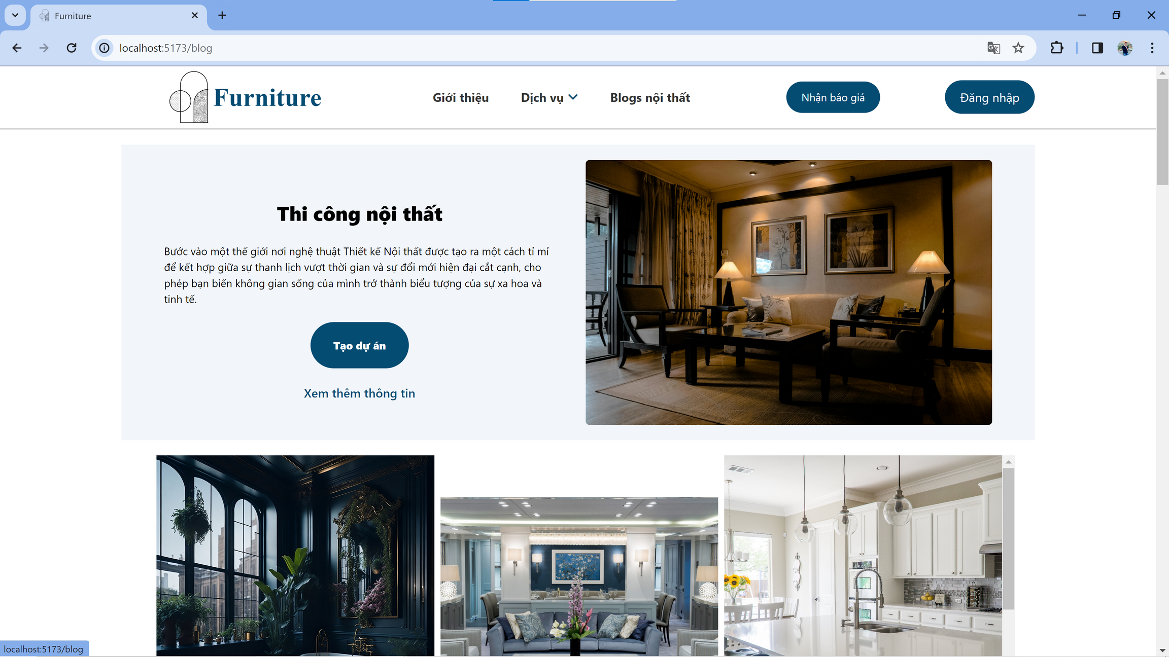

Slide 13
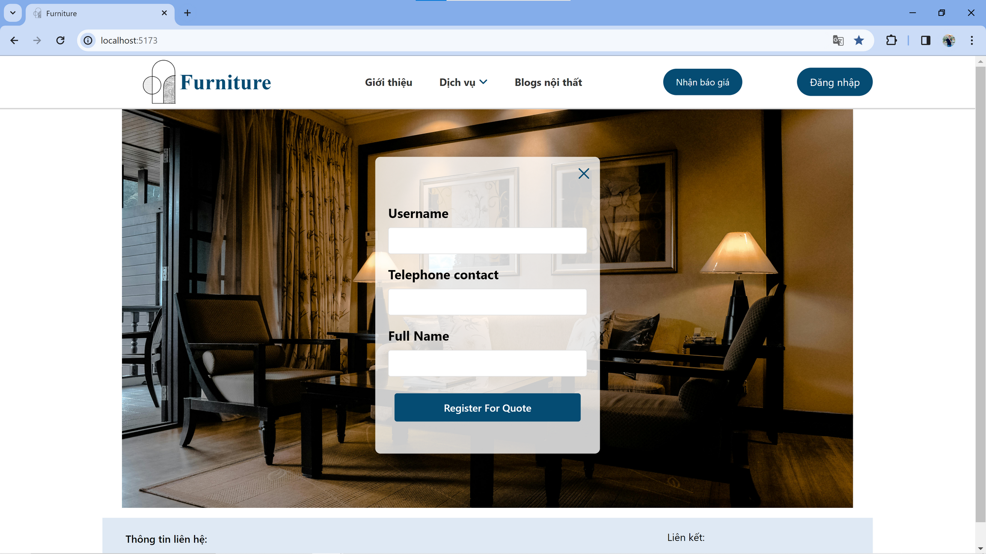

Slide 14
Customer

Slide 15
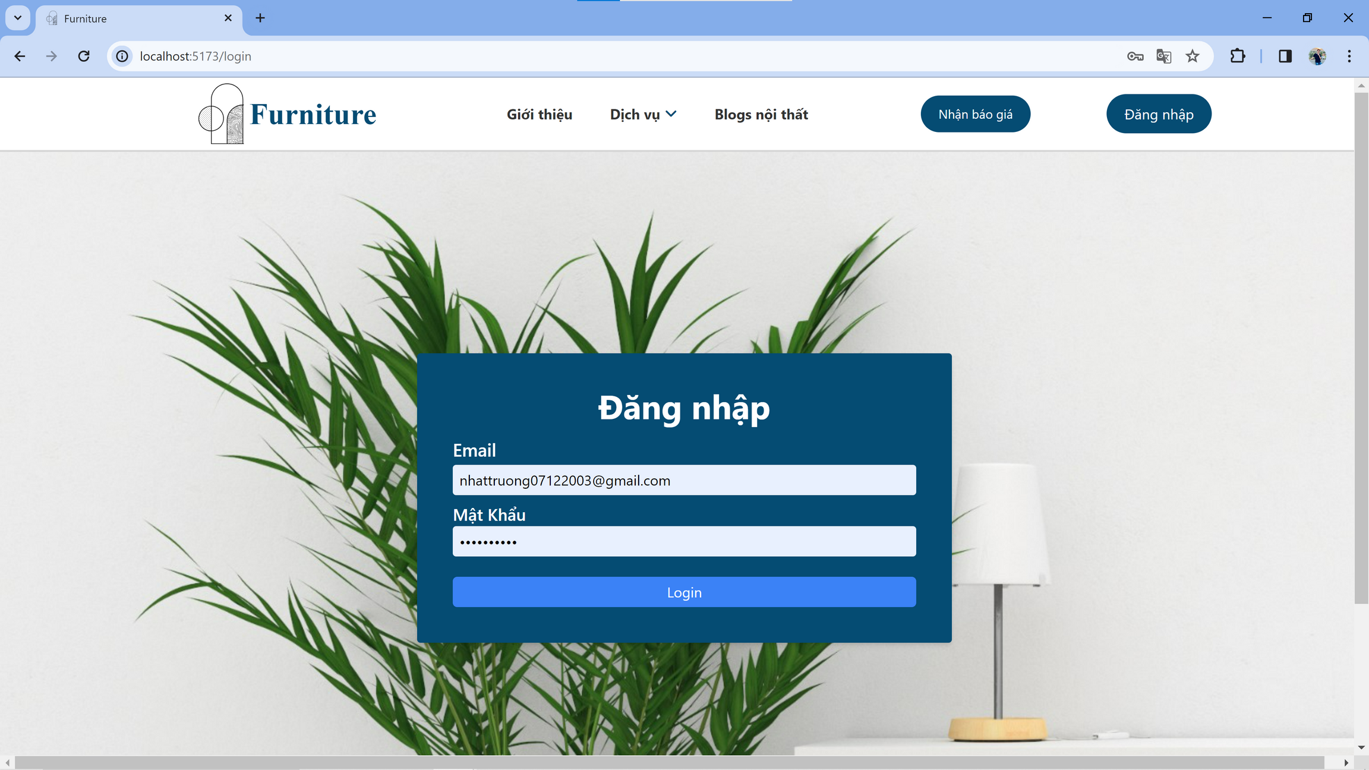

Slide 16
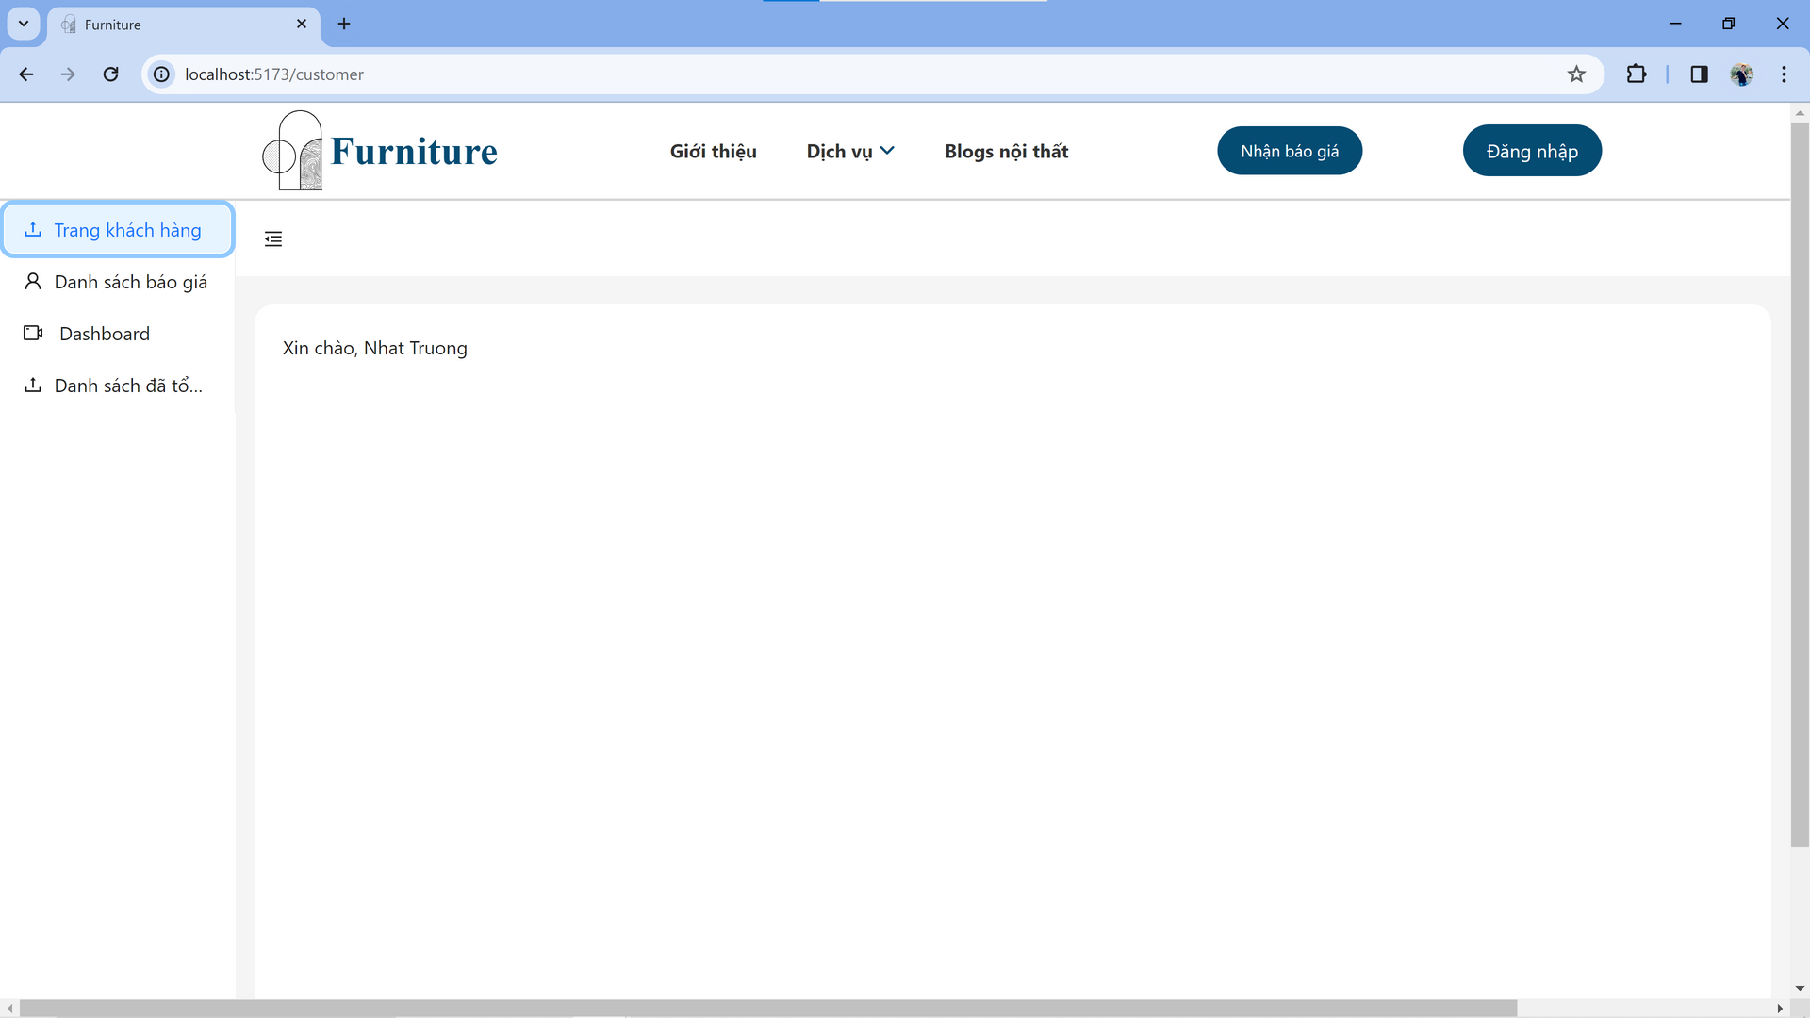

Slide 17
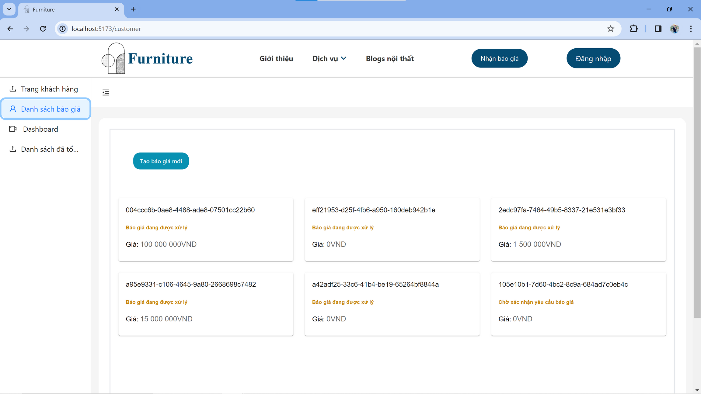

Slide 18
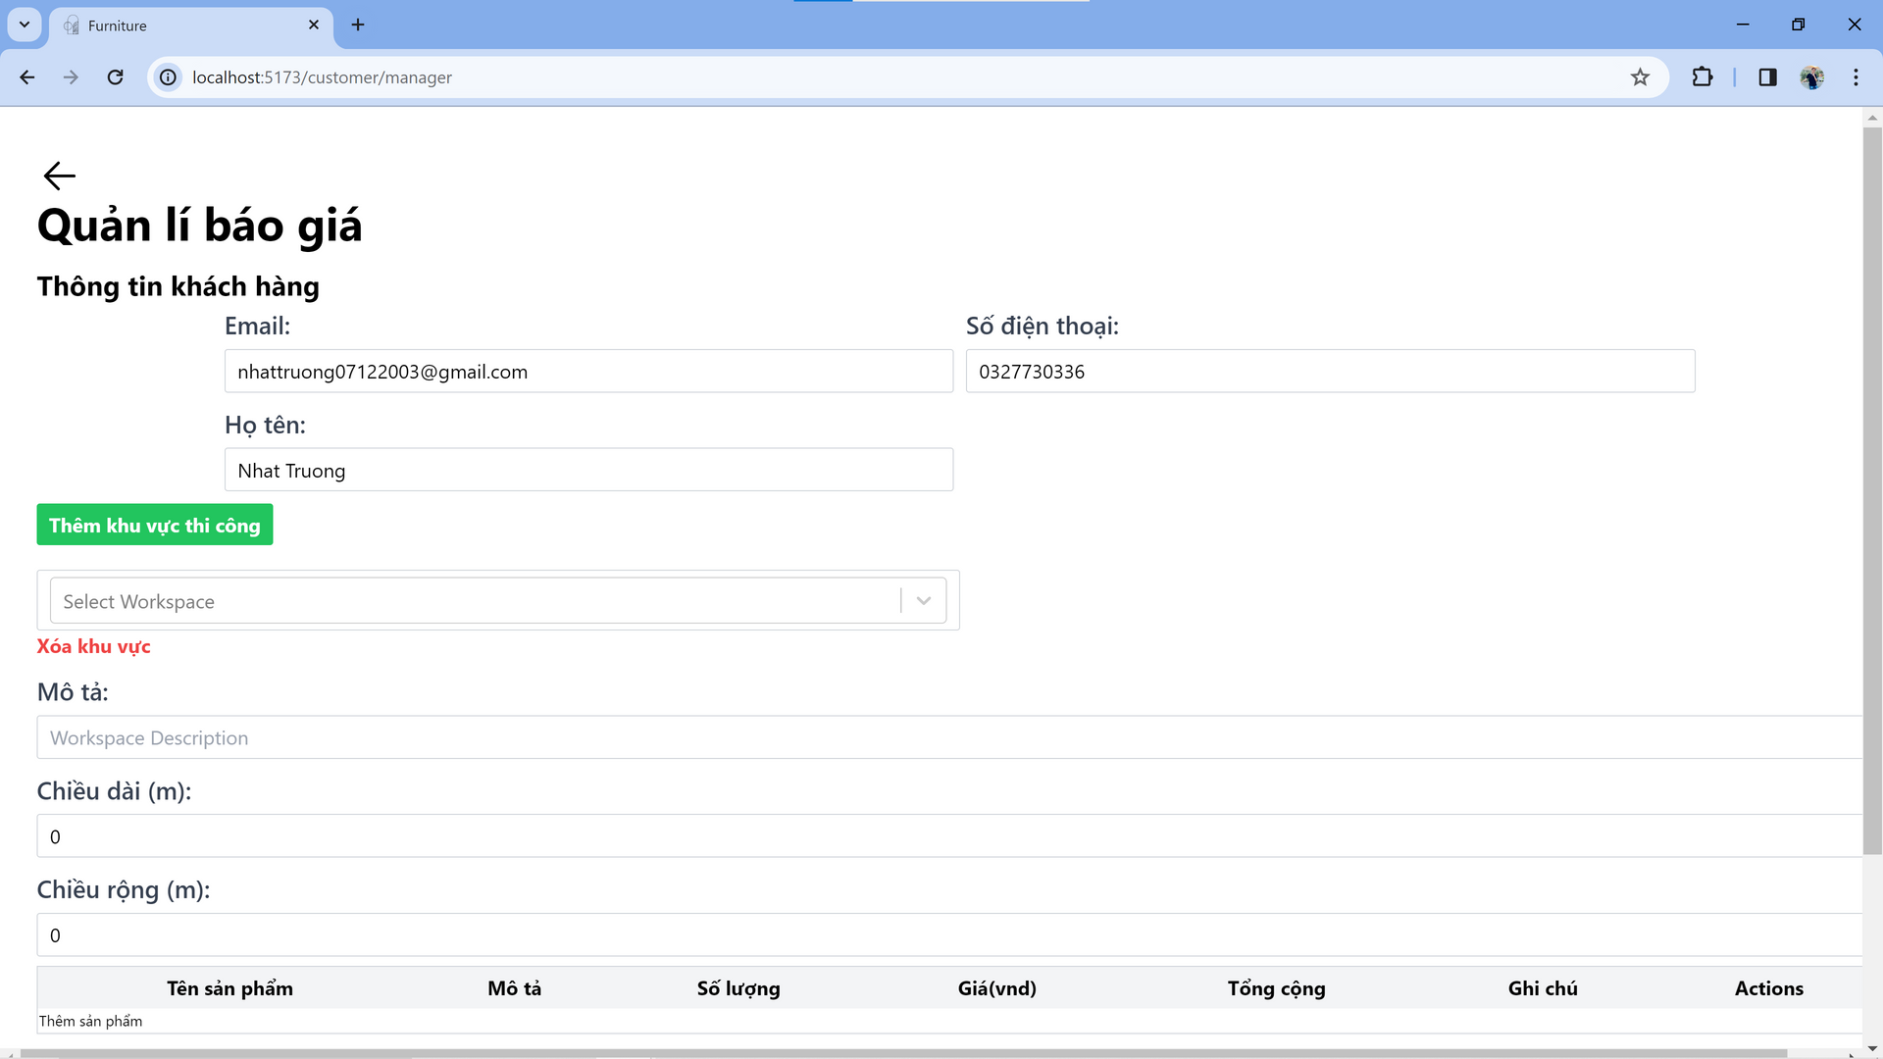

Slide 19
Staff

Slide 20
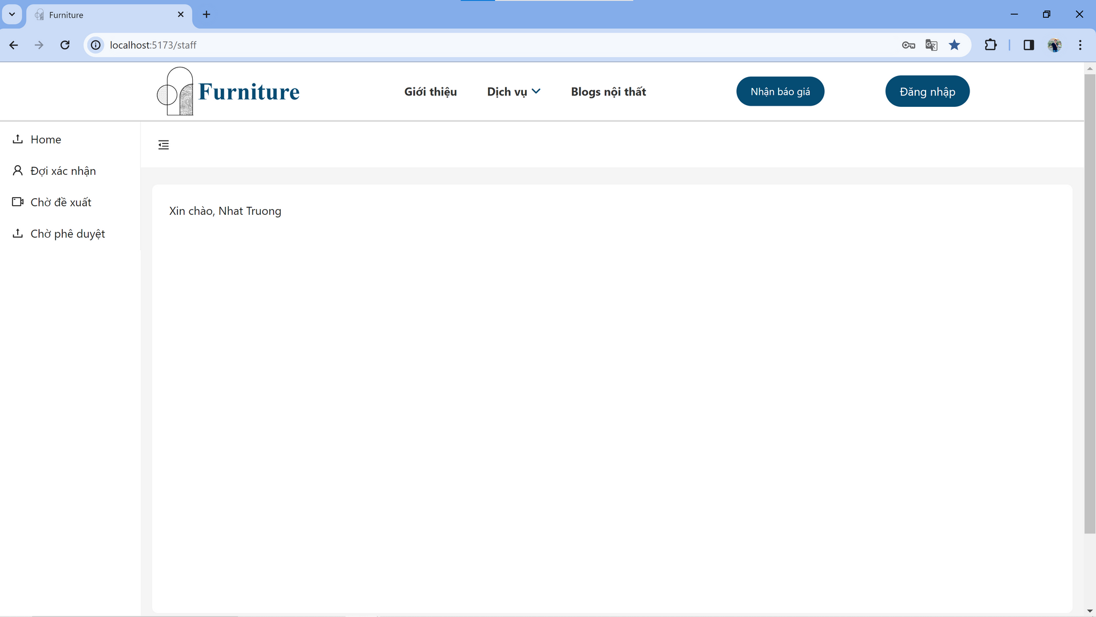

Slide 21
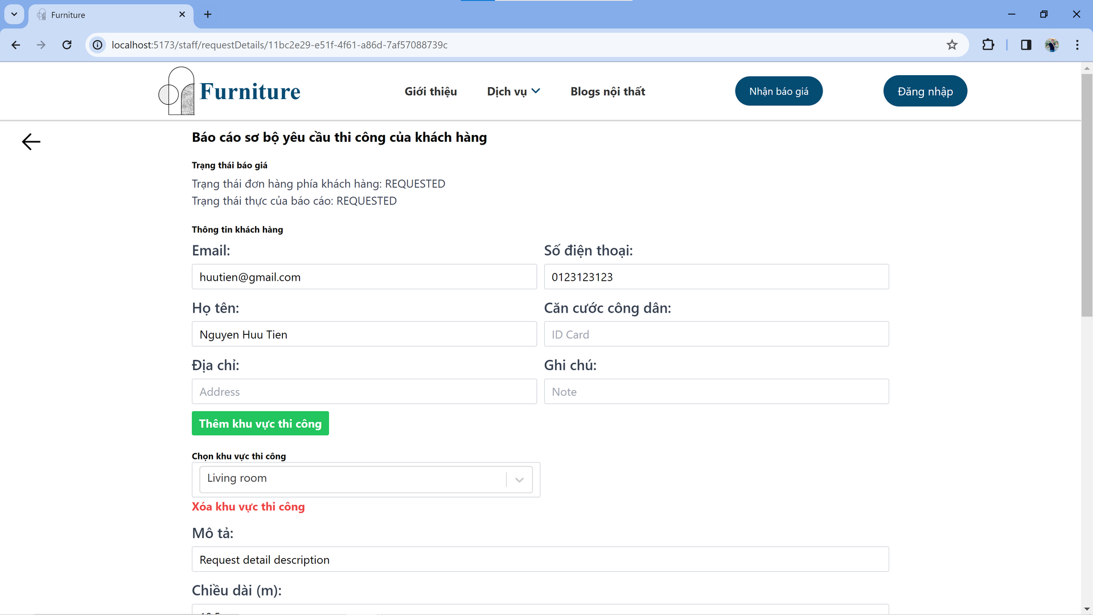

Slide 22
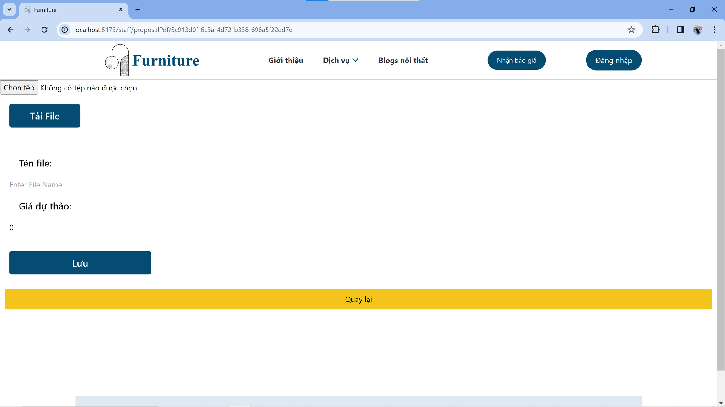

Slide 23
Manager

Slide 24
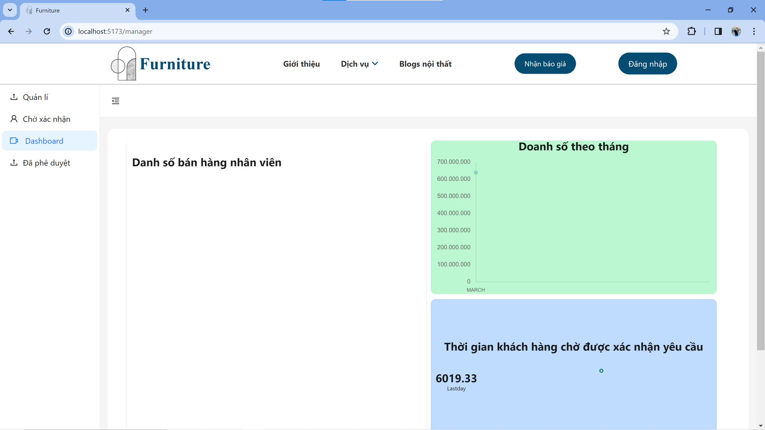

Slide 25
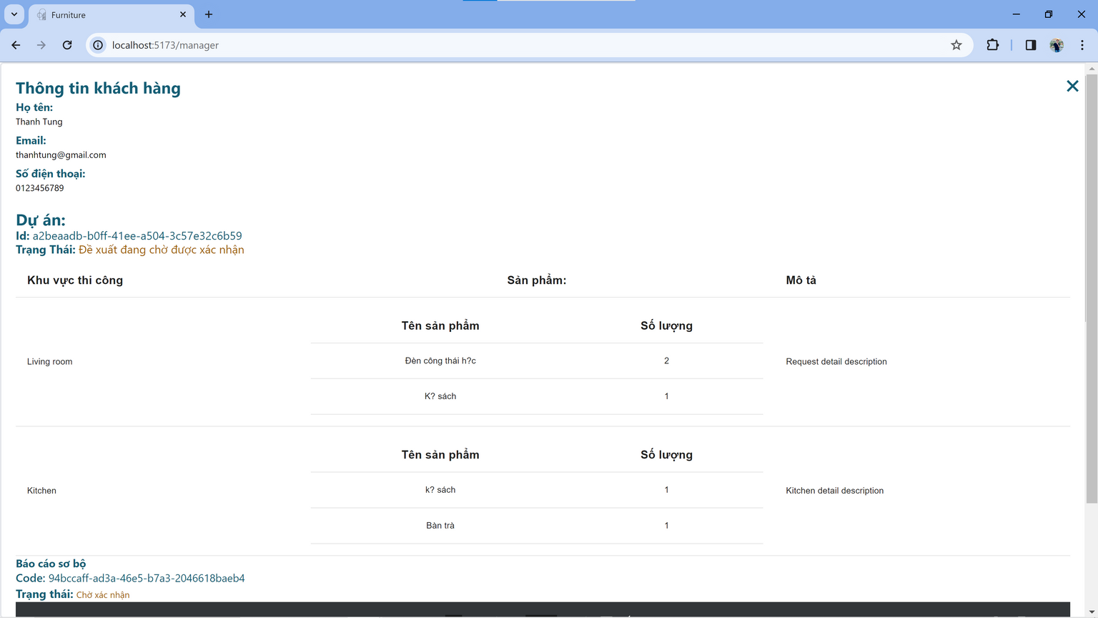
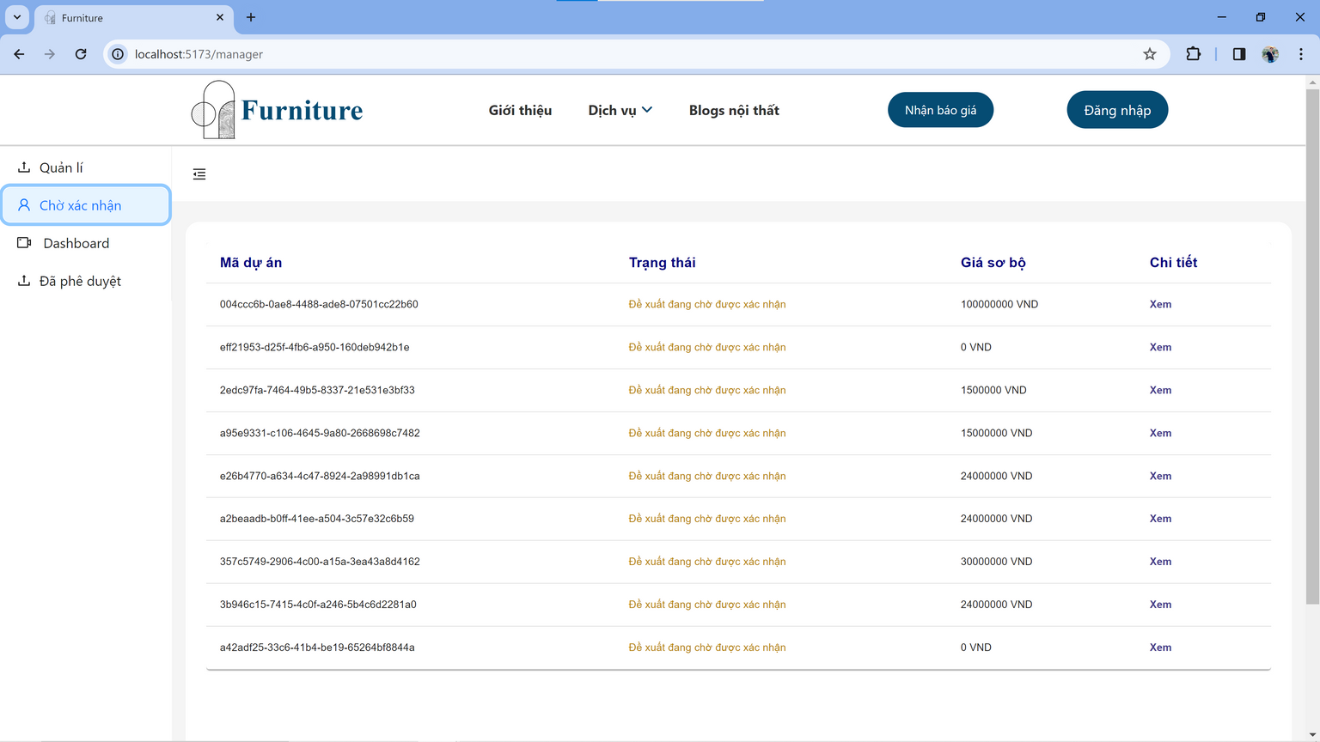
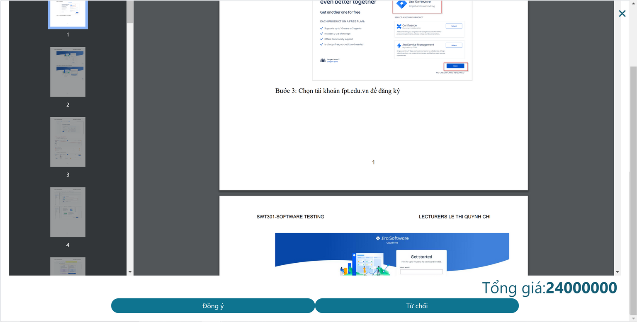

Slide 26
Admin

Slide 27
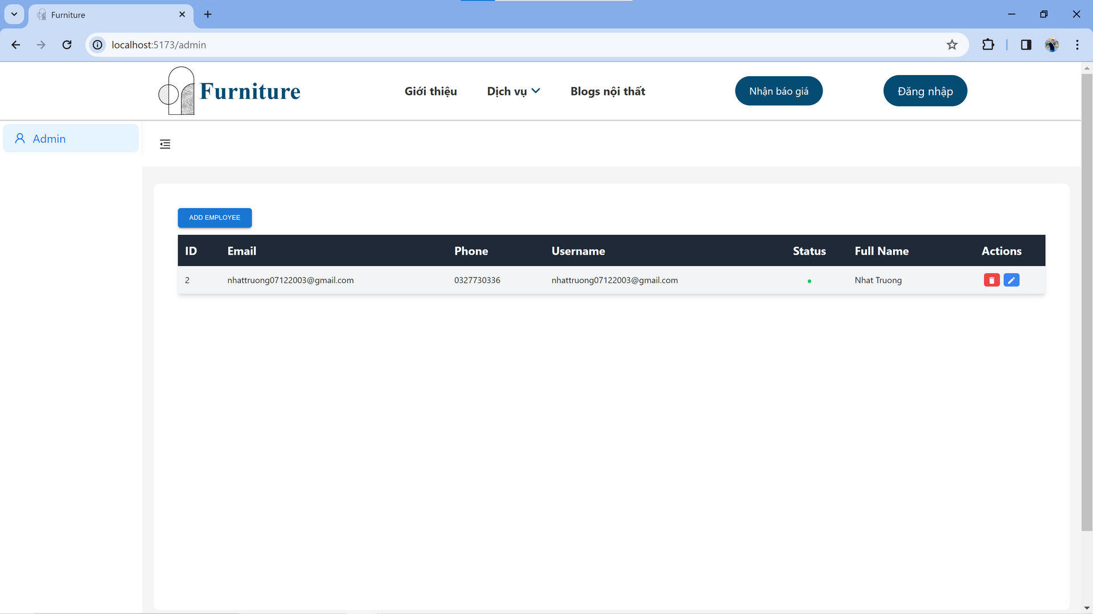

Slide 28
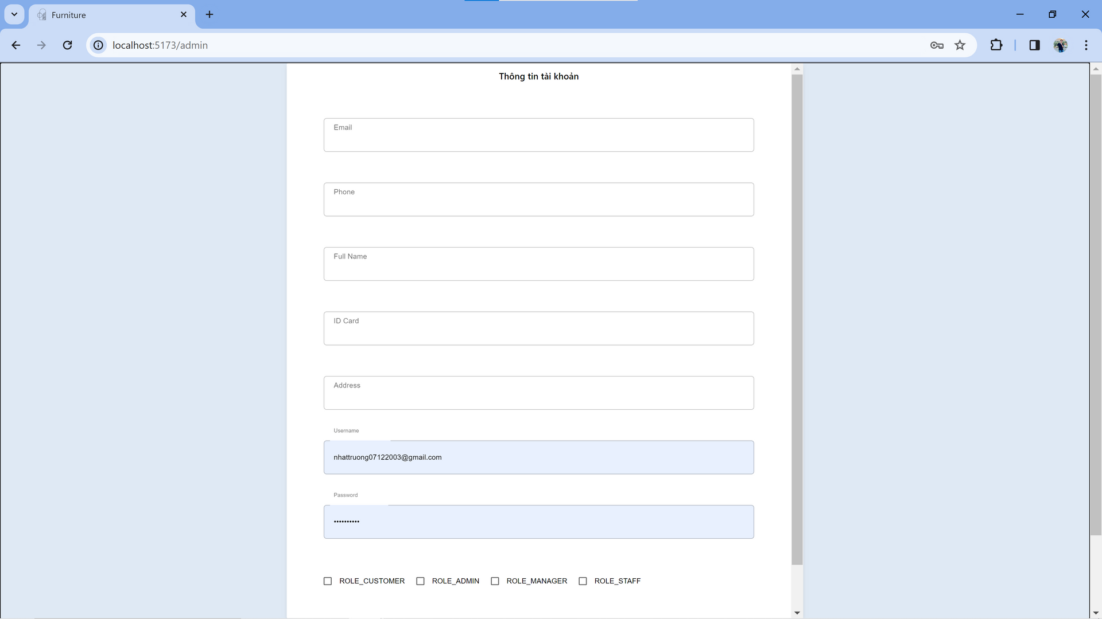

Slide 29








Technology:
Springboot
Ant Design
ReactJS
Google Firebase
TailwindCSS
MUI
Vite
GIT

Slide 30
Thanks for your listining

